Slide 1
Implementing a pipeline

Slide 2

First do module 3 on AWS
Notes:
It’s long and hard, but also very important.

Slide 3
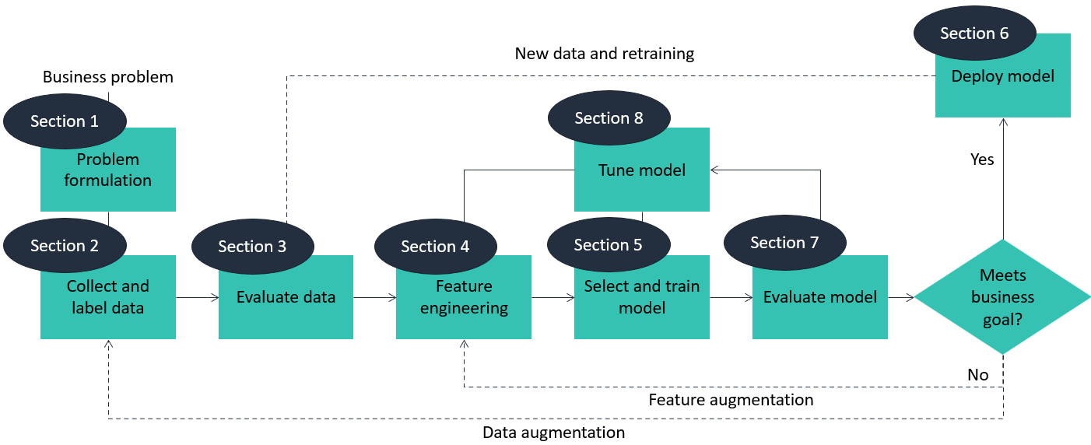
First do module 3 on AWS
Section 1: ntn
Section 2
Notes:
itn: nice to know
etn: need to know

